Slide 1
Understanding Trust in Mobile Crowdsensing Systems from the perspective of Security
Shameek Bhattacharjee
Western Michigan University
Email: shameek.bhattacharjee@wmich.edu

Slide 2
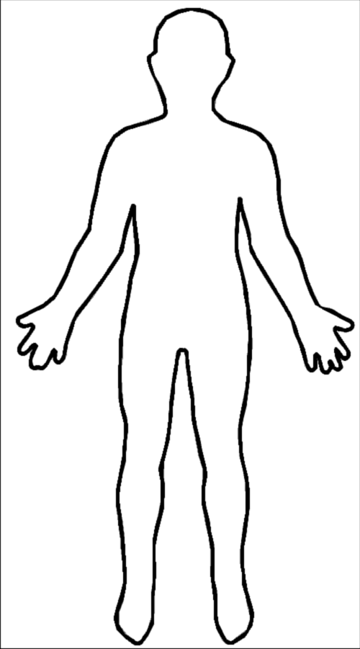

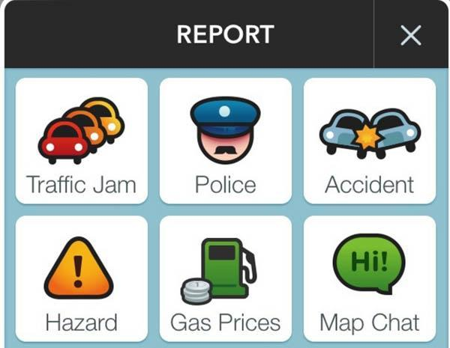

Event Trust
Feedback / Ratings
Contributions
Crowd
Sensing
Server
Event/Report
Published
Participatory Crowd Sensing (CS)
Raters
Reporters

Slide 3
Crowd Sensing Architecture
False Reports and Ratings
Event
Published
Reports
(Contributions)
Crowd
Sensing
Server
Feedback Monitoring
Consumers
Crowd Sensing (CS)
Report: Citizens contribute data, alert, notification.
3 aspects of Crowd-Sensing
(Published) Event: A consensus status inferred from the reports, e.g. jam, accident, road closure, weather hazard.
Feedback Monitoring: Endorsement on the published event
Viz. Ratings, e.g. Useful, Not useful, Not sure, 5 star ratings
Notes:
No ground truth is known, Feedback Monitoring is done by an Anomaly Detector or Humans themselves who are not reporters
Event true or false
User Trusted or not
Future event publish or not…based on priors..

Slide 4
Assumptions on Discussion
Trust Scores may capture ability, preferences, error, uncertainty level in an entity
The purpose of trust is to capture goodness of intent. (security status)
MCS system has been just deployed and we are starting from scratch. (no prior reputation available)
No ground truth available.
Nature of Events are not very subjective.
Events may have several types.

Slide 5
Threat Landscape in Crowd-Sensing
Exploits→ Use Hardware Emulators
Hack Mobile Apps, Fake-Loc. Apps
Why Selfish Intent ? (undue incentives)
Incentive mechanisms to motivate constant reports from users.
Incentivize based on degree of contribution (quantity) rather than quality of contributions.
(Huge # of false reports [Bhattacharjee et. al., IEEE CNS ’17] in Google Waze Dataset)
Feedback Weaponizing Attacks:
Ballot stuffing: Rogue raters give positive ratings to false events.
Bad mouthing: Rogue raters give false ratings to true events.
Obfuscation stuffing: Rogue raters give uncertain ratings to false events
Why Malicious Intent ?
Create congestion (civilian)
Drain company’s revenue (economic)
Strategic blocks or voids (internal security)
(Sinai et. al. DEFCON 14, News Reports LA)
Belief Manipulation Attacks:
Orchestrate a fake event in a location with high prior likelihood, with ballot stuffing.
Choose to suppress true events in a location low prior likelihood, with bad mouthing.
(exploiting the use of priors in decision making)
Reporting Behaviors:
Honest: mostly reports true events.
Selfish: intermittently generate true and false events. (2 groups)
Malicious: frequently collude on reporting the same false event type.
Notes:
.

Slide 6
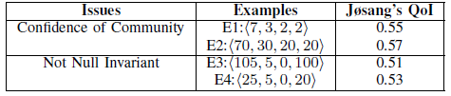
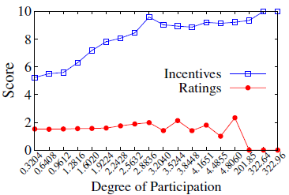
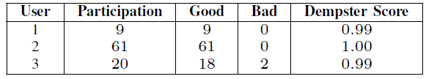
Weaknesses in Existing Computation trust models
E#: <$N,n_{α}$, $n_{β}$, $n_{γ}$> → Output of Feedback Monitoring Apparatus
Problems with Event Trustworthiness
Problems in existing Models (e.g., Josang’s Belief, Beta Reputation, Dempster Shafer Belief Theory)
Cannot embed variations in “quantity of ratings received”
Not Null Invariant
Sacrifice quality for participation
Sacrifice participation for quality
[ Bhattacharjee et. al.
IEEE Per-Com
Workshops 2017 ]
Study of Waze Dataset
Sacrificing Quality for Participation
Our Goals
Quantify Event Truthfulness
Establish User Reputation
Classify Users according to intent
Diminish Incentive Leakage
Sacrificing Participation for Quality

Slide 7
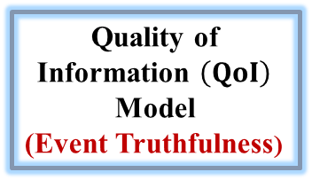
Proposed Framework
Reports
(Data)
Feedback Monitoring
Apparatus
Rating
Counts
Quality of Information $\left(QoI\right)$ Model
(Event Truthfulness)
All Event
QoI’s
QoI – Event Association
Database
(Evidence)
Improve
Report
Accuracy
User – Event Association Database(Evidence)
User Reputation Scoring Module
(User Trust Scoring)
Mitigate
Incentive
Losses
(Mitigation)
Reputation based:
Incentives
Event Publishing
Honest
Selfish
Malicious
Classification
(Detection)
Notes:
Anomaly detector itself is vulnerable….. Oohh .. What to do? Behavioral Psychology

Slide 8
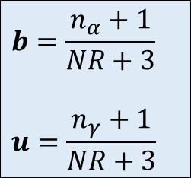
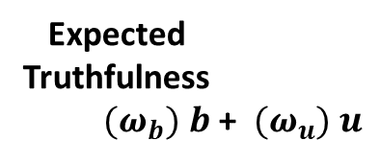
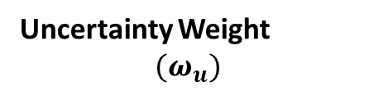

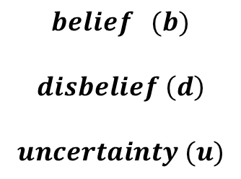
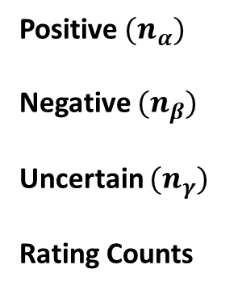
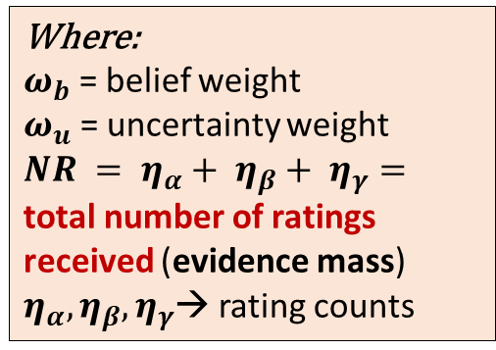
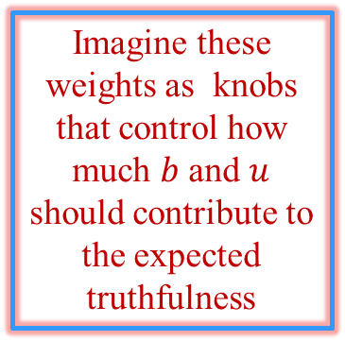
Quality of Information Module
Positive ${(n}_{α})$
Negative ${(n}_{β})$
Uncertain ${(n}_{γ})$
Rating Counts
$$belief (b)$$
$$disbelief \left(d\right)$$
$$uncertainty (u)$$
Non Linear Dual Weighted QoI Scoring
Module
Belief Weight $(ω_{b})$
Bayesian Estimation of Posterior Probability Masses
Uncertainty Weight
$$(ω_{u})$$
Expected
Truthfulness
$(ω_{b})$ $b$ + $(ω_{u})$ $u$
$$b=\frac{n_{α}+1}{NR+3}$$
$$u=\frac{n_{γ}+1}{NR+3}$$
Runs for each
published event k
Final Event
QoI
Generalized Linear Model based Link Function
Imagine these weights as knobs that control how much $b$ and $u$ should contribute to the expected truthfulness
Where:
$ω_{b}$ = belief weight
$ω_{u}$ = uncertainty weight
$NR = η_{α}+ η_{β}+ η_{γ}=$ total number of ratings received (evidence mass)
$η_{α}, η_{β},η_{γ}$→ rating counts
Notes:
View weights as knobs controlling how much of the b and u will contribute to my trustworthiness or expected belief.

Slide 9
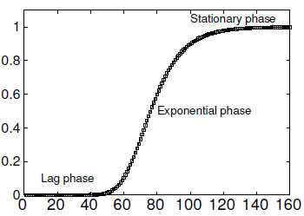
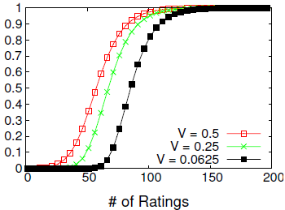
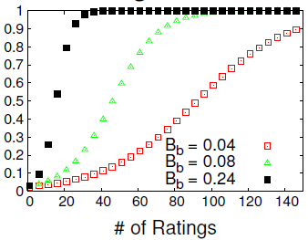

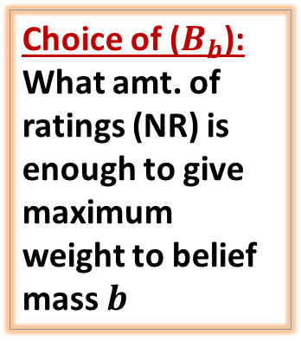


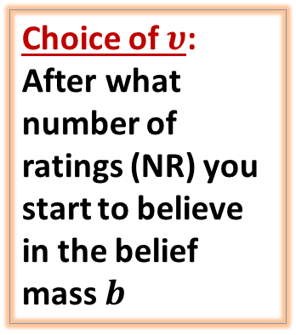

Belief Weight
Choice of $υ$:
After what number of ratings (NR) you start to believe in the belief mass $b$
Belief Weight $w_{b}$
Belief Weight $w_{b}$
# of ratings
Richard’s Logistic Curve
Choice of ($B_{b}$):
What amt. of ratings (NR) is enough to give maximum weight to belief mass $b$
Belief Weight $w_{b}$
= Initial Asymptote
= Rate of Growth
= Displacement Parameter
Resilience to Ballot Stuffing
Notes:
Incremental Change Process for Belief based Learning.

Slide 10
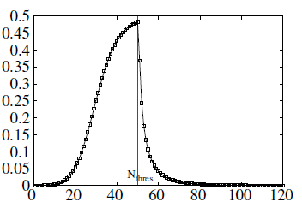
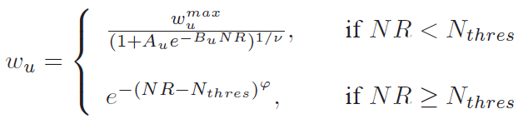
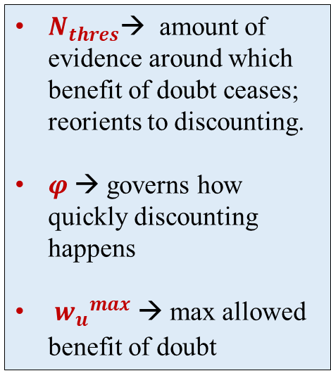

Uncertainty Weight
$N_{thres}$→ amount of evidence around which benefit of doubt ceases; reorients to discounting.
$φ$ → governs how quickly discounting happens
${w_{u}}_{}^{max}$ → max allowed benefit of doubt
Resilience to Obfuscation Stuffing
Uncertainty Weight $w_{u}$
# of ratings
Benefit of Doubt
Discounting of Doubt
Knot Point
Richards
Curve
Kohlsrausch Function
Notes:
Behavioral Psychologists have pointed that human interpretation of uncertainty into trustworthiness follows transformational change processes characterized by a knot point. Before the knot point, there is some benefit of doubt but never full benefit, and beyond a threshold of evidence/time, benefit of doubt ceases and discounting of the benefit starts.
If I have larger number of ratings the contribution of uncertainty evidence should be minimal, no matter how many uncertain ratings
If I have small number of ratings the uncertainty could be given some benefit.

Slide 11
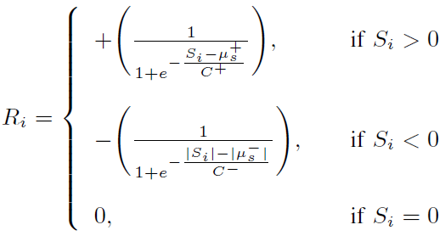

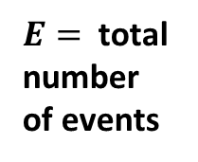
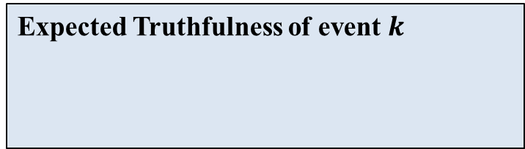


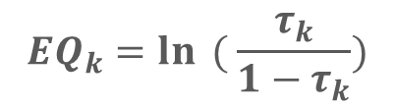

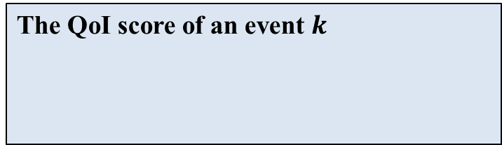
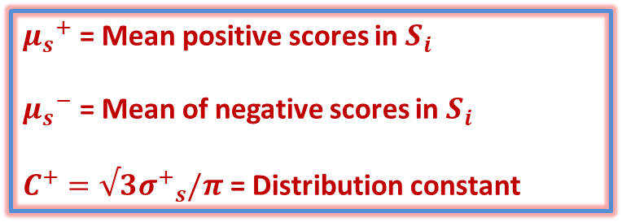
User Reputation Model
Expected Truthfulness of event $k$
${μ_{s}}^{+}$ = Mean positive scores in $S_{i}$
${μ_{s}}^{−}$ = Mean of negative scores in $S_{i}$
$C^{+}=√3{σ^{+}}_{s}/π$ = Distribution constant
Regression
Score
The QoI score of an event $k$
Logit Link Function
$${EQ}_{k}=\ln{ ( \frac{τ_{k}}{1−τ_{k}})}$$
Final User Reputation Score:
A scaled version of hyperbolic tangent function
Aggregate Score for user i
$$S_{i}= \sum_{k=1}^{E}{EQ_{k} I(k,i)}$$
$E=$total number
of events
$$I\left(k,i\right)=$$
$$\left\{\begin{aligned}1 \\ 0\end{aligned}\right.$$
→ If $i$ reported $k$
→ Otherwise
Notes:
GLM: Provides relationship between the mean of the response variable (categorical, non-normal) and the linear predictors (explanatory) in the model
CDF of a logistic distribution function that is a scaled version of the hyperbolic tangent function used in neural network.

Slide 12
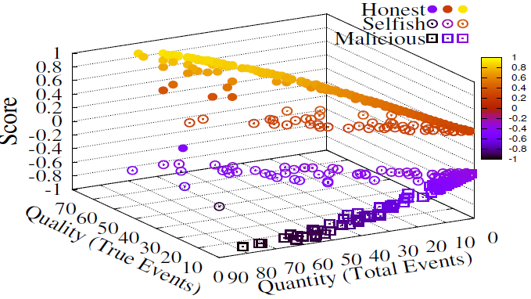
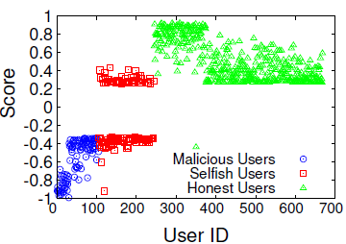
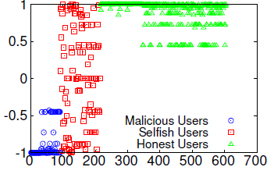
Results: Attack Detection
Classification Performance
Three distinct user groups classified
Lowest group: Malicious
Middle group: Selfish
Top group: Honest
Reputation Score unifies both quality and quantity of contributions
Selfish and malicious groups cannot increase reputation with just higher participation
Selfish users have two groups:
- Users →Higher true contributions
- Users → Higher false contributions
- Fairness in scores
- Can be used for incentives.
Better than Dempster Shafer
Classification Fairness Comparison : (1) Proposed (Left) (2) D-S Reputation (Right)

Slide 13
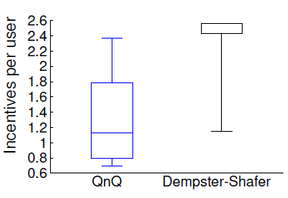
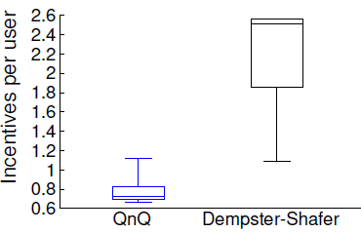
Results: Attack Mitigation
Incentive Mechanism:
Implemented incentive mechanism proposed in [Restuccia, et al., WoWMoM’14] with QnQ reputation scores.
Computed rewards for honest and selfish users using: (a) QnQ and (b) D-S reputation model.
Key Observations:
Rewards for honest users comparable (Not too restrictive)
For selfish users: mean incentive is more than 50% less than D-S
Prevents: loss of revenue due to rogue reporting.
Improves reliability
Honest
Selfish

Slide 14
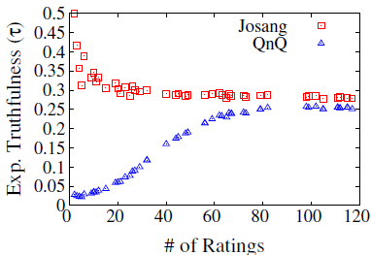
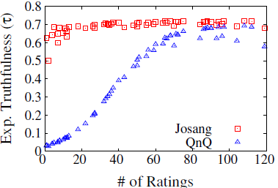

QoI Score Comparison
User (Meter)
Reports (Data)
Event (Consensus )
Ratings (Anomaly Detection)
Reputation based Incentive
User Reputation
Event QoI (Infer false report )

Slide 15
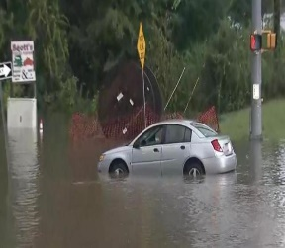
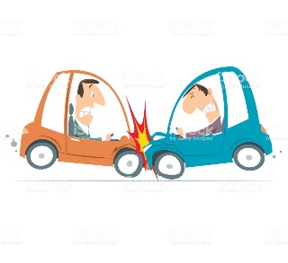
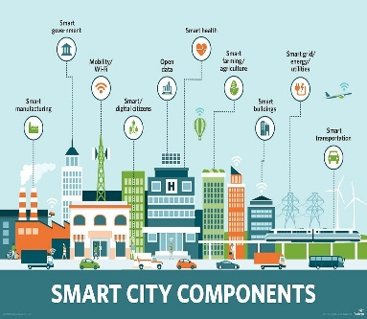
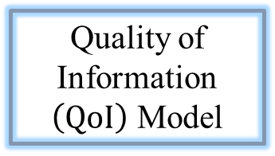
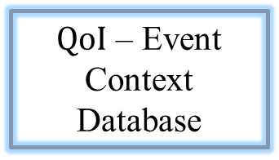
Reports
(Data)
Feedback Monitoring
Apparatus
Rating
Counts
Quality of Information $\left(QoI\right)$ Model
All Event
QoI’s
User – Event Association
Database
Improve
Decision
Accuracy
Risk Aware Decision Theoretic
Model
$QoI$ – Event Context Database
User Reputation Scoring Module
Honest
Selfish
Malicious
Classification
Criterion
Physical
World
Mitigate
Incentive
Losses
Reputation based
Incentive Models
Notes:
Anomaly detector itself is vulnerable….. Oohh .. What to do? Behavioral Psychology

